Slide 1
UNIT 4 TRANSPORT LAYER
Overview of Transport layer
Reliable end to end transmission
Protocols- UDP , TCP
TCP –connection management
Flow control
Retransmission
TCP congestion control
Congestion avoidance –DEC bit, RED
QOS
Prepared By
Ms. DEVIPRIYA S/ AP/ CSE

Slide 2
Introduction
The Transport Layer is responsible for peer-to-peer and end-to-end communication of data packets. It provides a number of important functions that are responsible for reliable, efficient, and organized data transfer between host systems in a networked environment.
Sender side:
Transport layer takes data from upper layer (i.e. Application layer) and then breaks it into smaller size segments, numbers each byte, and hands over to lower layer (Network Layer) for delivery.
Receiver side:
The data packets must be taken and sent to the appropriate machine by the network layer. After that, the transport layer receives the packets, sorts them, and looks for faults.
Subsequently, it directs them to the session layer of the appropriate computer program.
Now, the properly structured packets are used by the session layer to hold the data for the application.

Slide 3
Cont..
This Layer is the first one which breaks the information data, supplied by Application layer in to smaller units called segments. It numbers every byte in the segment and maintains their accounting and also ensures that data must be received in the same sequence in which it was sent.
This layer provides end-to-end delivery of data between hosts which may or may not belong to the same subnet.
All server processes intend to communicate over the network are equipped with well-known Transport Service Access Points (TSAPs) also known as port numbers.

Slide 4
Difference
Host-to-host communication is about delivering a packet of data between two physical devices (hosts) on a network, primarily handled by the Network Layer using IP addresses.
while process-to-process communication is about delivering that data to a specific running application (process) on the destination host, handled by the Transport Layer using port numbers.
process-to-process communication is about application-level data exchange between specific programs, whereas node-to-node is about delivering data between any two points on a network, such as routers or servers, using network-level protocols.

Slide 5
Services
The primary functions of the Transport Layer are:
End to End communication (Process to process communication)
Flow control
Reliable data delivery
Multiplexing and Demultiplexing
Connection Establishment (3 way handshake)
Connection Termination
QoS

Slide 6
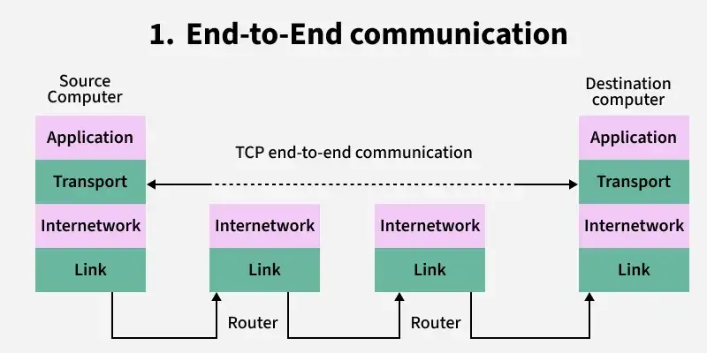
End to End Communication
End-to-end communication is the ability of the transport layer to provide the application a way to send and receive a stream of data. The network layer segments the data stream into packets that are sent over the network and reconstructs the data on the other end. If the data packets arrive out of order, it can reorder them by segment numbering and present the data in the correct order.

Slide 7
Flow Control
Flow control is the ability for the transport layer to avoid sending more data than can be reliably transmitted. It can buffer sending and receiving data until there is enough network capacity for it to go through. If the receiver buffer becomes full, it can reduce the sending rate. It also implements congestion control.
If a network were to become flooded with too many retransmit messages, it would be overwhelmed and not able to recover. Congestion control prevents this by using dynamic retransmission timers and slow start.

Slide 8
Reliable data delivery
Reliability is the ability to correct errors that can happen during data transmission over the network.
If data were to be accidentally changed in transit, error correcting and checksums would catch it.
If a packet were to be lost, it would be caught and retransmitted.
If a single packet were to be duplicated, it could be detected and dropped. It can also send an acknowledgement of received packets for guaranteed delivery.
Some protocols send a message if a packet is not received or is corrupt.

Slide 9
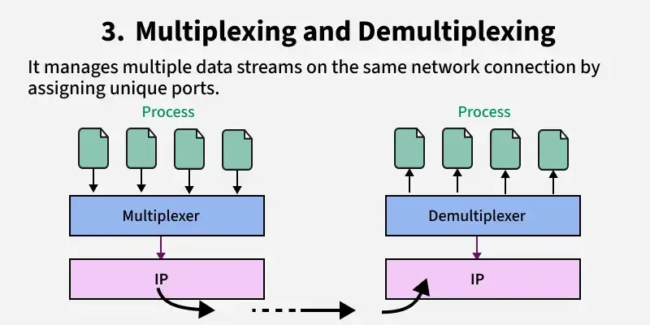
Multiplexing and Demultiplexing
Multiplexing is the ability for any number of applications to use any number of network connections. For example, a typical desktop computer may only have one Ethernet network connection but have several connections to the internet running at the same time, such as a web browser, video streaming and a mail client.
Conversely, a large server may only have one application, such as a SQL server, but have two physical Ethernet connections to provide as much bandwidth as possible.
The transport layer ensures that each application gets a fair amount of shared network connections.

Slide 10
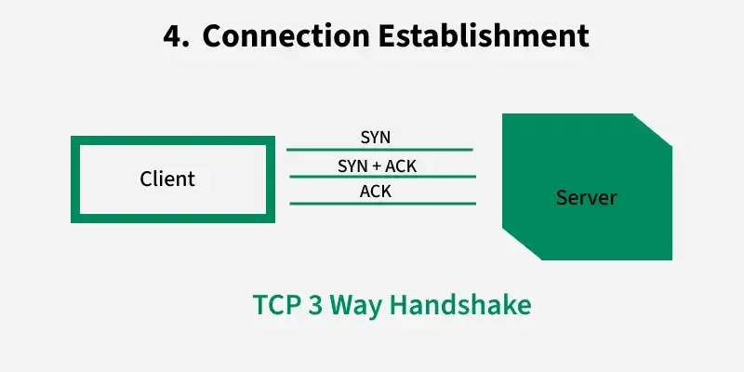
Connection Establishment

Slide 11
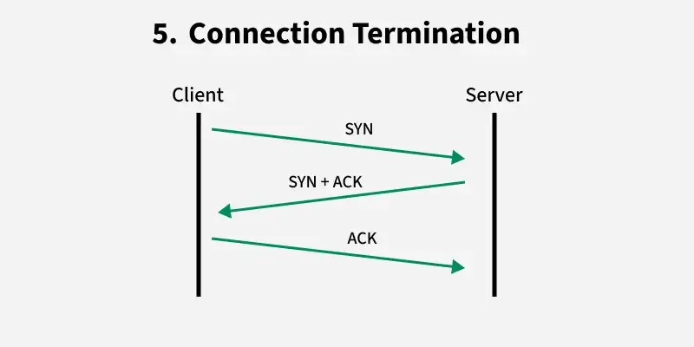
Connection Termination

Slide 12
QOS (Quality of Service)
It ensures priority and performance for specific types of data, like video calls or file transfers.

Slide 13
Protocols
Transmission Control Protocol − It provides reliable communication between two hosts.
User Datagram Protocol − It provides unreliable communication between two hosts.

